Slide 1
What we learned so far:
Euler Circuit Problem. Theorem and algorithm
Greedy Algorithms
  Interval scheduling and interval partitioning problems. Algorithms, correctness, running time.
  MST: Kruskal and Prim Algorithms, theorem, running times with different data structures.
  Single-source shortest path: Dijkstra algorithm: algorithm, running time and correctness.
Divide and Conquer: divide, recur, and conquer
  Merge sort: algorithm and running time
  Counting Inversions: algorithms and running: two jobs are easier than one.
  Mid-term covers week 1 to week 6. (not including dynamic programming algorithms)
How to prepare mid-term exam: go through notes/tutorials/in-class exercises. If you want to get A+, read related chapters in the text book.

Slide 2
Dynamic Programming

Slide 3
Basic Idea
* Break problems into subproblems and combine their solutions into solutions to larger problems.
In contrast to divide-and-conquer, dynamic programming uses memorization: each sub-problem is solved only once and the result of each sub-problem is stored in a table

Slide 4
1. Weighted Interval Scheduling

Slide 5
Weighted Interval Scheduling
Weighted interval scheduling problem.
  Job j starts at s_{j}, finishes at f_{j}, and has weight or value v_{j} .
  Two jobs compatible if they don't overlap.
  Goal: find a subset of pairwise compatible (nonoverlapping) jobs with maximal total value.
3
a
2
b
5
c
7
d
9
e
7
f
6
g
5
h
Time
0
1
2
3
4
5
6
7
8
9
10
11

Slide 6
Unweighted Interval Scheduling Review
Unweighted Interval scheduling (all weights=1) => select as many compatible jobs as possible.
Recall. Greedy algorithm works if all weights are 1 .
  Consider jobs in ascending order of finish time.
  Add job to subset if it is compatible with previously selected jobs.
Observation. Greedy algorithm can fail spectacularly if arbitrary weights are allowed.
weight = 999
b
weight = 1
a
Time
0
1
2
3
4
5
6
7
8
9
10
11

Slide 7
Weighted Interval Scheduling
Notation. Label jobs by finish time: f₁ ≤ f₂ ≤ . . . ≤ f_{n} .
Def. p(j) = largest index i < j such that job i is compatible with j.
Ex: p(8) = 5, p(7) = 3, p(2) = 0.
Observation: all jobs p(j)+1, …, j-1 are incompatible with j; and all jobs 1, …, p(j) are compatible with j.
1
2
3
4
5
6
7
8
Time
0
1
2
3
4
5
6
7
8
9
10
11
Notes:
The index of the last job that finishes before the start time of job i.

Slide 8
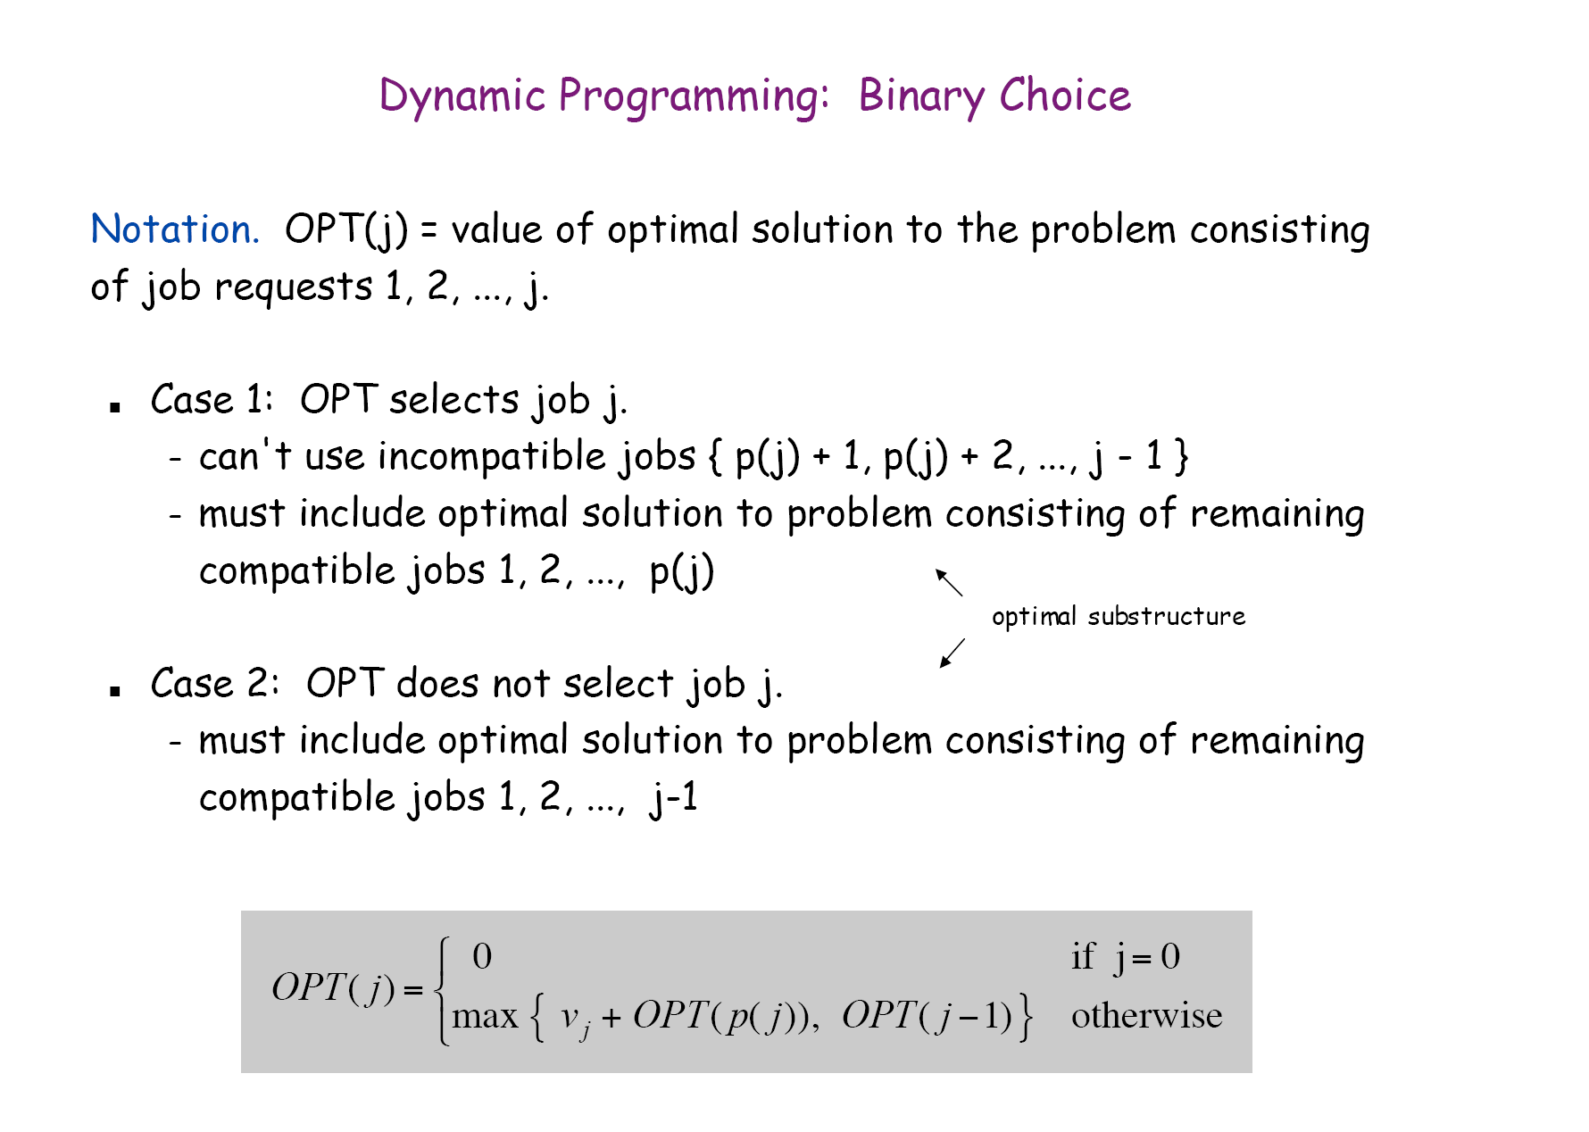
chapter25

Slide 9
Recursive Algorithm:
Compute-Opt(n)
if n=0 then
return 0
else
return max {v_{n}+Compute-Opt(p(n)), Compute-Opt(n-1)}
Running time: >2^{n/2}.
(not required)
chapter25

Slide 10
Observation. Recursive algorithm fails spectacularly because of redundant sub-problems ⇒ exponential algorithms.
Ex. Number of recursive calls for family of "layered" instances grows like Fibonacci sequence.
5
1
4
3
2
3
3
2
2
1
4
2
1
1
0
1
0
5
p(1) = 0, p(j) = j-2
1
0

Slide 11
Index
v₁=2
p(1)=0
1
v₂=4
p(2)=0
2
v₃=4
p(3)=1
3
v₄=7
p(4)=0
4
v₅=2
p(5)=3
5
v₆=1
p(6)=3
6
chapter25

Slide 12
Weighted Interval Scheduling: Bottom-Up
Input: n, s₁, s₂, …, s_{n}, f₁, f₂, …, f_{n}, v₁, v₂, …, v_{n}
Sort jobs by finish times so that f₁≤f₂≤ … ≤f_{n}.
Compute p(1), p(2) , …, p(n)
M[0]=0;
for j = 1 to n do
M[j] = max { v_{j}+M[p(j)], M[j-1]}
if (M[j] == M[j-1]) then B[j]=0 else B[j]=1 /*for backtracking
m=n; /*** Backtracking
while ( m ≠0) { if (B[m]==1) then
print job m; m=p(m)
else
m=m-1 }
/* Memoization
B[j]=0 indicating job j is not selected.
B[j]=1 indicating job j is selected.
chapter25

Slide 13
0 1 2 3 4 5 6
Index
M =
0
2
w₁=2
p(1)=0
1
w₂=4
p(2)=0
0
2
4
2
w₃=4
p(3)=1
3
0
2
4
6
w₄=7
p(4)=0
4
w₅=2
p(5)=3
0
2
4
6
7
5
w₆=1
6
p(6)=3
0
2
4
6
7
8
M[j] = max { v_{j}+M[p(j)], M[j-1]}
0
2
4
6
7
8
8
M[2]=w2+M[0]=4+0;
M[3]=w3+M[1]=4+2;
M[4]=W4+M[0]=7+0;
M[5]=W5+M[3]=2+6;
M[6]=w6+M[3]=1+6<8;
j: 0 1 2 3 4 5 6
B: 0 1 1 1 1 1 0
Backtracking: job1, job 3, job 5
chapter25

Slide 14
Computing p()’s in O(n) time
p()’s can be computed in O(n) time using two sorted lists, one sorted by finish time and the other sorted by start time.
Start time: b(0, 5), a(1, 3), e(3, 8), c(5, 6), d(6, 8)
Finish time: a(1, 3), b(0,5), c(5,6), d(6,8), e(3,8)
p(d)=c, p(c )=b, p(e)= a, p(a)=0, p(b)=0. (See demo)
chapter25

Slide 15
Time complexity
Sorting the jobs: O(n log n)
Computing p(): O(n) time after sorting all the jobs based on the starting times ( O (n log n) ) .
The whole loop O(n) (each pass: O(1) )
The backtracking O(n)
Time complexity: O(n log n) including sorting.
chapter25

Slide 16
Example 2:
v(a)=2, v(b)=3, v(c )=5, v(d) =6, v(e)=8.8
Start time: b(0, 5), a(1, 3), e(3, 8), c(5, 6), d(6, 8)
Finish time a(1, 3), b(0,5), c(5,6), d(6,8), e(3,8)
p(d)=c, p(c )=b, p(e)= a, p(a)=0, p(b)=0.
Solution: M[0]=0, M[a]=2. M[b]=max{2, 3+M[p(b)]}=3.
M[c]=max{3, 5+M[p(c )]}=5+M[b]=8.
M[d]=max{8, 6+M[p(d)]}=6+M[c]=6+8=14.
M[e]=max{14, 8.8+M[p(e)]}=max{14, 8.8+M[a]}=max {14, 10.8}=14.
Backtracking: b, c, d. Job: a b c d e
B: 1 1 1 1 0
chapter25

Slide 17
Chanllenge Q1: Billboard placement (Not Required)
You are trying to decide where to place billboards on a highway that goes East-West for M miles. The possible sites for billboards are given by numbers x₁, …, x_{n}, each in the interval [0, M]. If you place a billboard at location x_{i}, you get a revenue r_{i}.
You have to follow a regulation: no two of the billboards can be within less than or equal to 5 miles of each other.
You want to place billboards at a subset of the sites so that you maximize your revenue subject to this constraint.
How?

Slide 18
2. Manhattan Tourist Problem

Slide 19
Manhattan Tourist Problem: Formulation
Goal: Find the longest path in a weighted grid
Input: A weighted grid G with two distinct vertices, one labeled “source” and the other labeled “sink”.
(We can only go from left to right and from top to bottom.)
Output: A longest path in G from “source” to “sink”

Slide 20
MTP: An Example
0
1
2
3
4
j coordinates
source
3
2
4
0
0
1
0
2
4
3
3
2
4
2
1
1
4
6
5
2
0
7
3
4
2
i coordinates
4
4
5
2
1
3
3
0
2
3
5
6
8
5
3
1
3
2
2
sink
4

Slide 21
MTP: An Example
0
1
2
3
4
j coordinates
source
3
3
2
5
4
9
0
0
0
1
0
2
4
3
3
2
4
13
2
1
1
4
6
5
2
0
7
3
15
4
19
2
i coordinates
4
4
5
2
1
3
3
0
2
3
20
5
6
8
5
3
1
3
2
2
23
sink
4

Slide 22
MTP: An Example
0
1
2
3
4
j coordinates
source
3
3
2
5
4
9
0
0
0
1
0
2
4
3
1
3
4
2
4
13
2
1
1
4
6
5
2
0
10
7
17
3
15
4
19
2
i coordinates
4
4
5
2
1
3
3
22
0
2
3
20
5
6
8
5
3
1
3
30
2
32
2
34
sink
4

Slide 23
MTP: Recurrence
Computing the score for a point (i,j) by the recurrence relation:
s_{i-1, j} + weight of the edge between (i-1, j) and (i, j)
s_{i, j-1} + weight of the edge between (i, j-1) and (i, j)
s_{i, j} =
max
the running time is n x m for a n by m grid
(n = # of rows, m = # of columns)

Slide 24
MTP: Dynamic Programming
j
0
1
source
0
1
1
i
S_{0,1} = 1
5
1
5
S_{1,0} = 5
Instead of recursion, store the result in an array S

Slide 25
MTP: Dynamic Programming
j
0
1
2
source
0
1
2
1
3
i
S_{0,2} = 3
5
3
1
-5
5
4
S_{1,1} = 4
3
2
8
S_{2,0} = 8

Slide 26
MTP: Dynamic Programming
j
0
1
2
3
source
0
1
2
5
1
3
8
i
S_{3,0} = 8
5
3
10
1
-5
1
5
4
13
S_{1,2} = 13
3
5
2
-5
8
9
S_{2,1} = 9
0
3
8
S_{3,0} = 8

Slide 27
MTP: Dynamic Programming
j
0
1
2
3
source
0
1
2
5
1
3
8
i
5
3
10
-5
1
-5
1
-5
5
4
13
8
S_{1,3} = 8
3
5
-3
-5
3
2
8
9
12
S_{2,2} = 12
0
0
3
0
8
9
S_{3,1} = 9

Slide 28
MTP: Dynamic Programming (cont’d)
j
0
1
2
3
source
0
1
2
5
1
3
8
i
5
3
10
-5
1
-5
1
-5
5
4
13
8
3
5
-3
2
-5
3
3
2
8
9
12
15
S_{2,3} = 15
0
0
-5
3
0
0
8
9
9
S_{3,2} = 9

Slide 29
MTP: Dynamic Programming (cont’d)
j
0
1
2
3
source
0
1
2
5
1
3
8
Done!
i
5
3
10
-5
1
-5
1
-5
5
4
13
8
3
5
-3
2
(showing all back-traces)
-5
3
3
2
8
9
12
15
0
0
-5
1
0
0
0
3
8
9
9
16
S_{3,3} = 16

Slide 30
Exercises
Exercise 1: For the weighted interval scheduling problem, there are eight jobs with starting time and finish time as follows: j1=(0, 8), j2=(2, 3), j3=(3, 6), j4=(5, 9), j5=(8, 12), j6=(9, 11), j7=(10, 13) and j8=(11, 16). The weight for each job is as follows: v1=3.5, v2=2.0, v3=3.0, v4=3.0, v5=6.5, v6=2.5, v7=12.0, and v8=8.0.
Find a maximum weight subset of mutually compatible jobs. (Backtracking process is required.) (You have to compute p()’s. The process of computing p()’s is NOT required.)
Exercise: Write the pseudo codes for the Manhattan Tourist problem. Please pay attention to the backtracking process.
chapter25

